Slide 1

The Rise of Fake News in the Political Scene
By Michael Mahoney

Slide 2

Presentation Overview
Quick intro to the data
Talk about misinformation and what we found
Explore some recommendations
Talk about the future

Slide 3

Who is This Presentation For

Slide 4

Misinformation
The Cost 79 Billion
37 billion in losses on the stock market
17 billion in losses annually from false/misleading financial information
9.54 billion spent on reputation management for false information about companies.
3 billion has been already spent to combat fake news.
400 million spent by US public institutions defending against misinformation.
250 million spent on brand safety measure.

Slide 5
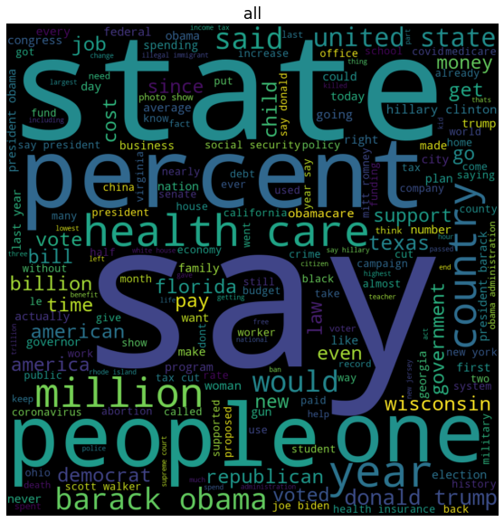
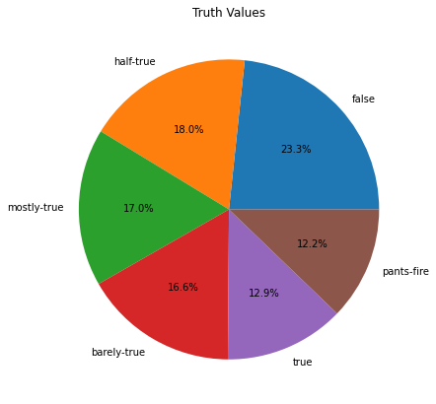
Our Data

Slide 6
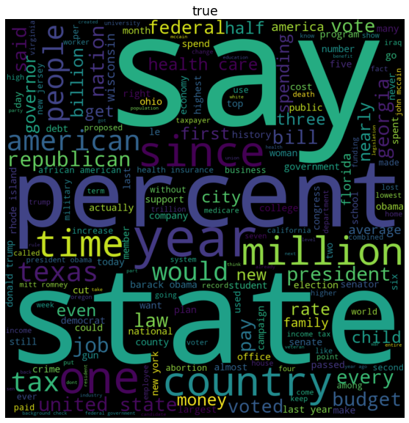
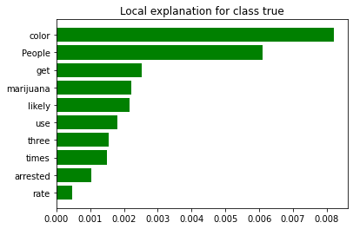
True
TRUE QUOTE
People of color and those of not, they use marijuana at the same rate. People of color are three times more likely to get arrested and convicted.

Slide 7
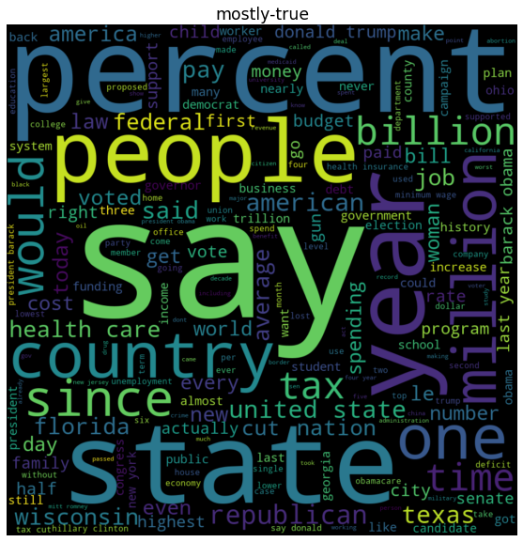
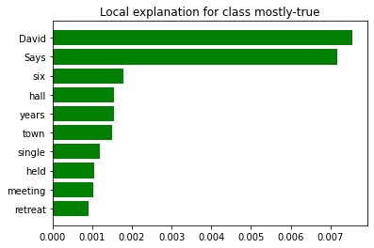
MOSTLY-TRUE
MOSTLY-TRUE QUOTE
Says David Perdue hasn't held a single public town hall meeting in six years and sells four meetings a year and a retreat on a private island for a $7,500 corporate PAC check.

Slide 8
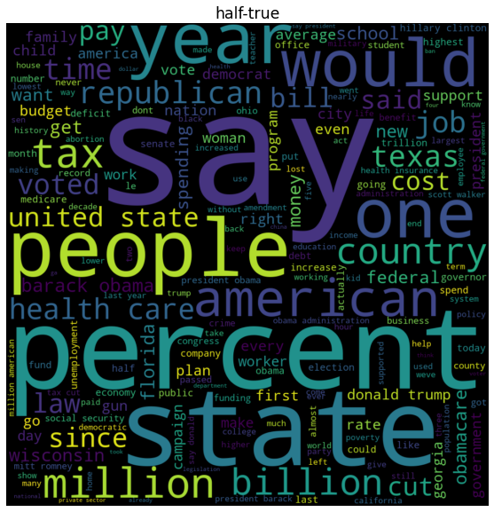
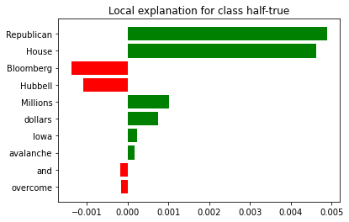
HALF-TRUE
HALF-TRUE
Millions of Hubbell and Bloomberg dollars wasn’t enough to overcome the Iowa House Republican avalanche of success.'

Slide 9
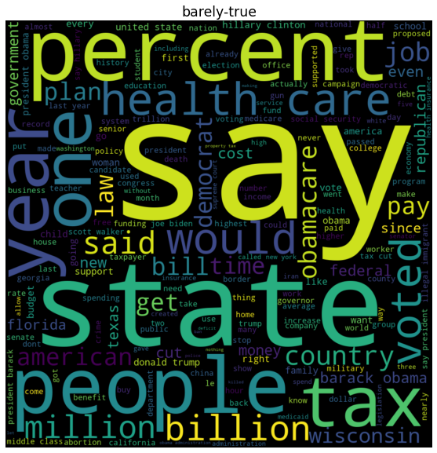
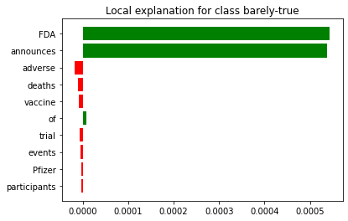
BARELY-TRUE
BARELY-TRUE QUOTE
FDA announces 2 deaths of Pfizer vaccine trial participants from serious adverse events.

Slide 10
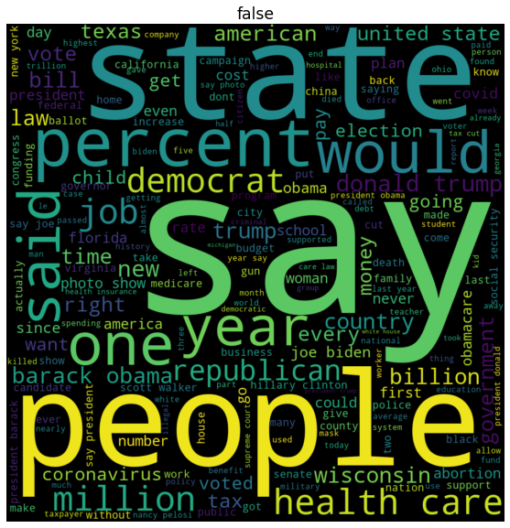
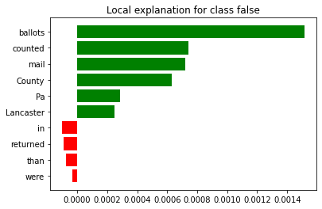
False
FALSE QUOTE
More mail-in ballots were counted in Lancaster County, Pa., than were returned

Slide 11
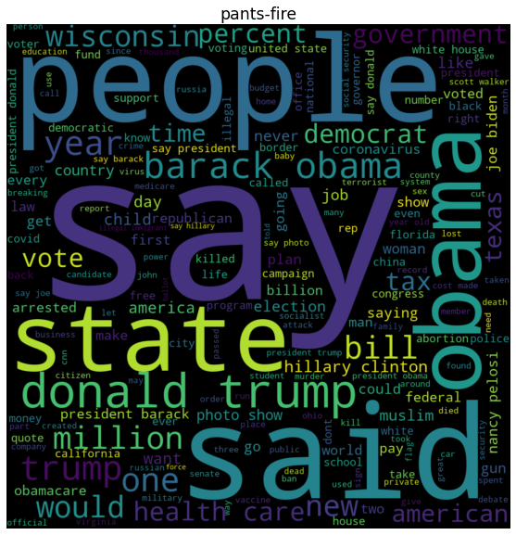
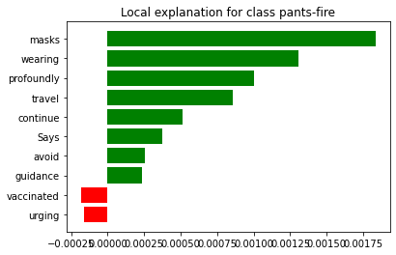
PANTS-FIRE
PANTS-FIRE QUOTE
Says that guidance urging vaccinated people to avoid travel and continue wearing masks is 'profoundly anti-science.'

Slide 12

Misinformation
False is easyish
True is less easy
Anything else is hard

Slide 13
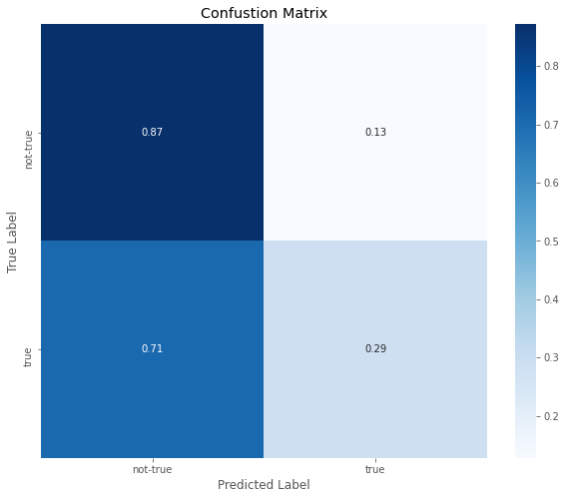
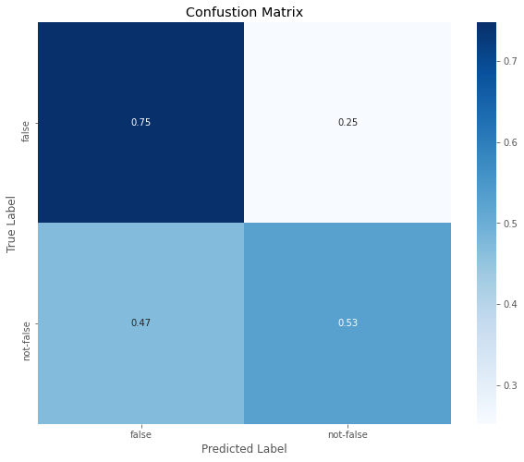
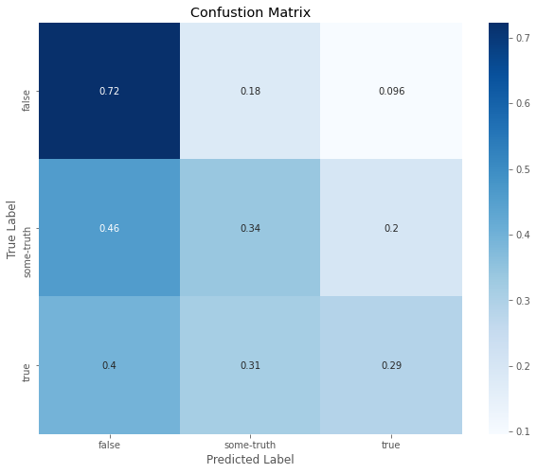
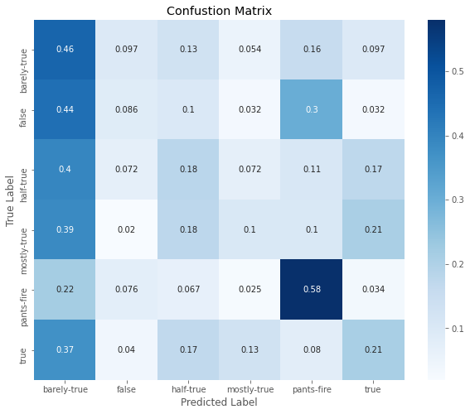
MODELS

Slide 14

What to do about it?

Slide 15

Resource Dedication
For those wishing to devote resources to fight misinformation; virtually all clusters of the false quotes center around presidential elections and candidates. Resources should be ramped up and deployed at times of heightened contention during presidential elections and primaries.

Slide 16

Politics
For politicians, most misinformation is based around people and not issues (with the notable exception of health care). If you wish to advance legislation, decoupling the issue from individuals will the best way to limit misinformation's impact.

Slide 17

Perpetuating Information
For Journalists, bloggers and people at large: Email chains, social media posts and viral content should never be used as a source for content.

Slide 18

Future Work
I would like to bring in some more quotes.
The second modeling goal is to implement a version of a BERT transformer.
As for the data exploration; I would like to make more use of the various NLTK apis for text engineering.
I would like to make the data more interactive on the app such that users can select specific quotes and interact with them through the various text models.

Slide 19
References
Ashish Vaswani, Noam Shazeer, Niki Parmar, Jakob Uszkoreit, Llion Jones, Aidan N. Gomez, Lukasz Kaiser, Illia Polosukhin: Attention is All you Need. NIPS 2017: 5998-6008
Jacob Devlin, Ming-Wei Chang, Kenton Lee, Kristina Toutanova: BERT: Pre-training of Deep Bidirectional Transformers for Language Understanding. NAACL-HLT (1) 2019: 4171-4186
Keras Developers: Keras API Docs: https://keras.io/api/
Ployly Developers: Plotly API Docs: https://dash.plotly.com/
Scikit Learn Developers: Scikit Learn API Docs: https://scikit-learn.org/stable/modules/classes.html
Pandas Developers: Pandas API Docs: https://github.com/pandas-dev/pandas
Jacob Kessler: ScatterText: https://github.com/JasonKessler/scattertext
Marco Tulio Correia Ribeiro: Lime: https://github.com/marcotcr/lime
Radim Rehrek, Petr Sojka: Software Frameword for Topic Modelling with Large Corpora: Proceedings of the LREC 2010 Workshop on New Challenges for NLP Frameworks: p. 45 - 50 : 2010: ELRA: Valletta, Malta
Andreas Mueller: word-cloud: https://github.com/amueller/word_cloud

Slide 20

Thank you

